Slide 1
Start:
If checkStoredSpeedValues == none:
promptUserForValues()
runMotorsFromValues()
If liquidLevels == low:
print “levels are low”
end program
User Interface:
Display{“Oil Speed:” + valueA, “Cat Speed” + valueB}
If buttonUp is pushed:
valueA = valueA + moreSpeed
If buttonDown is pushed:
valueA = valueA – moreSpeed
If buttonLeft is pushed:
valueB = valueB + moreSpeed
If buttonRight is pushed:
valueB = valueB – moreSpeed
If resetButton is pushed:
input = stop
Main Loop:
If flowSensor is on:
plasmaReactor = on
If plasmaReactor is on:
valveOpenToBiodieselReservoir()
Else:
valveOpenToWaste()
If input == stop:
return
If liquidLevels == low:
print “levels are low”
return
RunMotorsFromValues:
runOilMotorSpeed = valueA
runCatalystMotor = valueB
Check Sensors:
If photoResistor reads bright:
plasmaReactor = on
If Reservoir is tooHigh:
liquidLevels = low
If flowSensor reads flow:
flowSensor = on
If OilLevel or CatalystLevel reads low:
liquidLevels = low

Slide 2
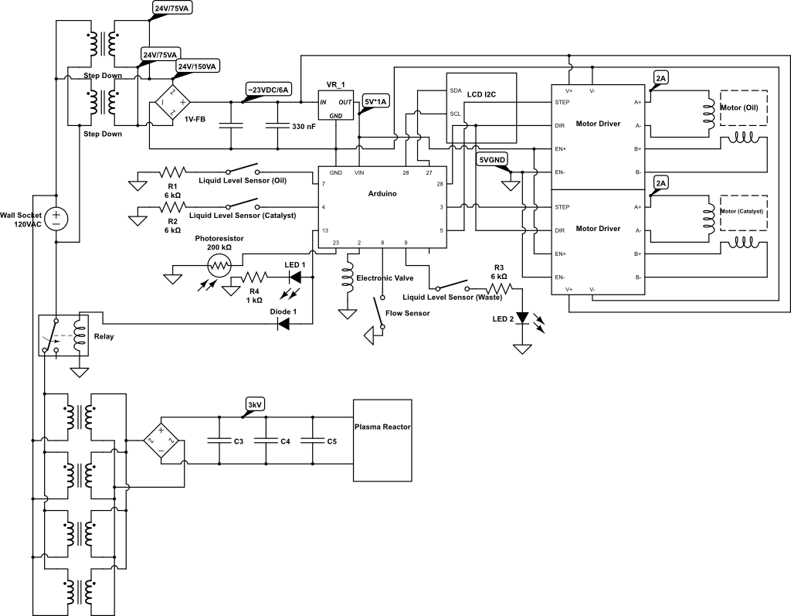

Slide 3
Oil Motor Speed: 127
Catalyst Motor Speed: 36

